Slide 1
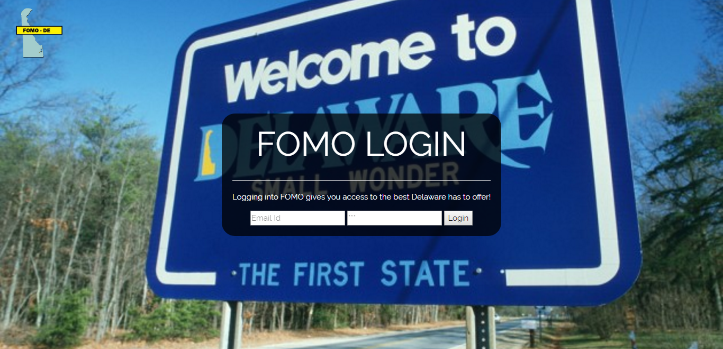

Slide 2

Current Problem

Slide 3
Pipeline Solution
Graduation → Career → Events → In-Sate Housing

Slide 4
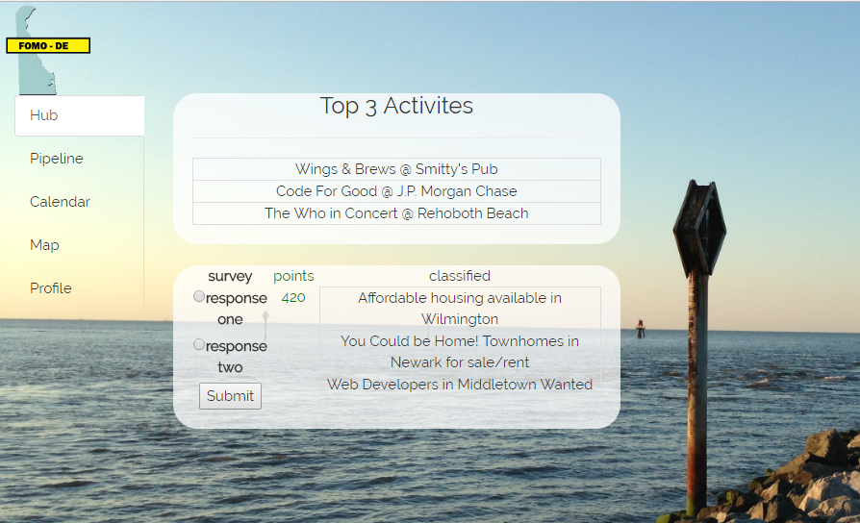

Slide 5
Engagement

Slide 6
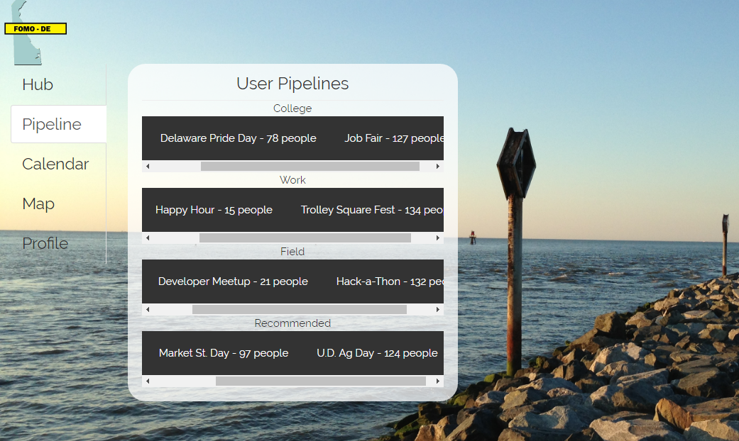

Slide 7
Calendar and
Event Visualization

Slide 8
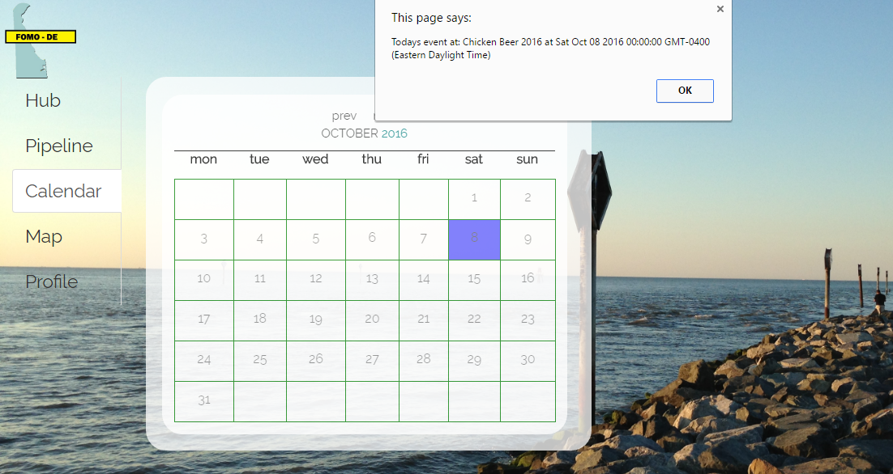

Slide 9
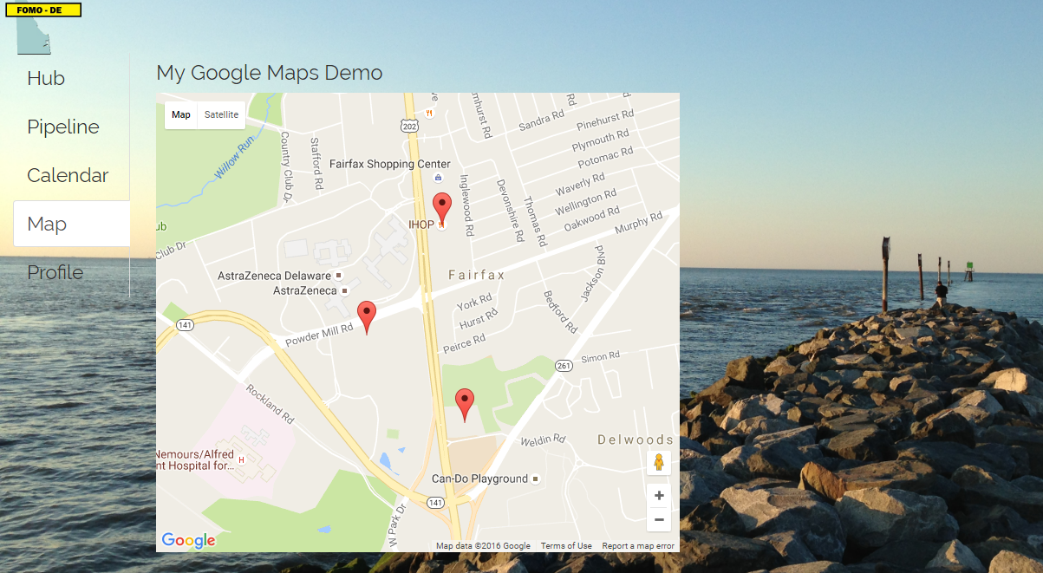

Slide 10
Data Collection

Slide 11
